Slide 1
CARS Faculty Survey Results (Summer 2020)
Rahbel Rahman
&
Kimberly Hudson
DRAFT – DO NOT DISTRIBUTE

Slide 2
Overview
Goals related to faculty survey
To determine a model for better communicating faculty scholarly interests through GSS website in order to increase visibility and easy access to faculty research information.
To increase opportunities for collaboration with other faculty/researchers, community partners, and prospective students.
Survey results
Spring 2020
24 full-time faculty responded
Reviewed approaches from other SW schools for website development, options

Slide 3
What might our new research/scholarship webpages look like?
Criteria for model:
Organizes faculty information in at least 2 ways
Easy to toggle/navigate between these 2 ways
Links to faculty bio page with contact information
Organizes faculty research areas into broad categories, but allows for additional specification
Categories and/or subcategories should incorporate: substantive areas (topics), practice areas/settings, methodology/methods, and theoretical frameworks

Slide 4
Example
University at Buffalo model

Slide 5
CATEGORIES included in survey
Practice Areas that Inform Scholarship (6)
Theoretical Perspectives (5, subcategories TBD)
Research Methods (3, with 20 subcategories)
Research Focus Areas (15, subcategories TBD)
NOTE: CARS FACULTY DETERMINED THAT “FOCUS AREAS” WERE THE MOST IMPORTANT CATEGORIES TO INCLUDE, FOLLOWED BY SOME PRACTICE AREAS AND SOME METHODS. FINAL LIST OF CATEGORIES AND SUBCATEGORIES TBD, see next page)

Slide 6
DRAFT LIST OF GSS SCHOLARSHIP CATEGORIES (subcategories TBD)
Individuals & Families
Communities & Organizations
Policy Practice
Research Design & Measurement
Program Development & Evaluation
Intervention Research
PAR/CBPR
Health/Public Health
Stress & Coping, Trauma & Resilience
Social Identities/Categories & Intersectionality
Race & Ethnicity
Immigrants & Refugees
Disability
Gender & Sexuality
Child Welfare
Criminal Justice
Substance & Addiction
Violence
Adolescent & Youth Development
School Social Work
Aging & Gerontology
Poverty & Inequality
International Social Work & Global Issues
Social Work education

Slide 7
NEXT STEPS
Connor & Hanna looped in, technical info shared (10/30)
Approval needed from admin (Ji Seon) for Connor and Hanna to begin creating draft versions of the updated site
Connor & Hanna will work with Kimberly & Rahbel to develop new site, integrating feedback/suggestions from CARS committee and Faculty Council

Slide 8
Extra slides

Slide 9
Scholarly Collaborations
Faculty are more inclined to partner with faculty in other universities, community partners, non-academic partners and students more so than Fordham and GSS faculty.
 | Mean | Standard Deviation | Minimum | Maximum
GSS faculty | 3.95 | 1.04 | 2 | 5
Non-GSS Fordham faculty | 3.83 | 1.27 | 1 | 3
Faculty in other universities | 4.5 | 0.58 | 3 | 5
Non-academic researchers | 4.26 | 0.86 | 3 | 5
Students | 4.08 | 0.99 | 2 | 5
Community partners | 4.3 | 0.76 | 3 | 5

Slide 10
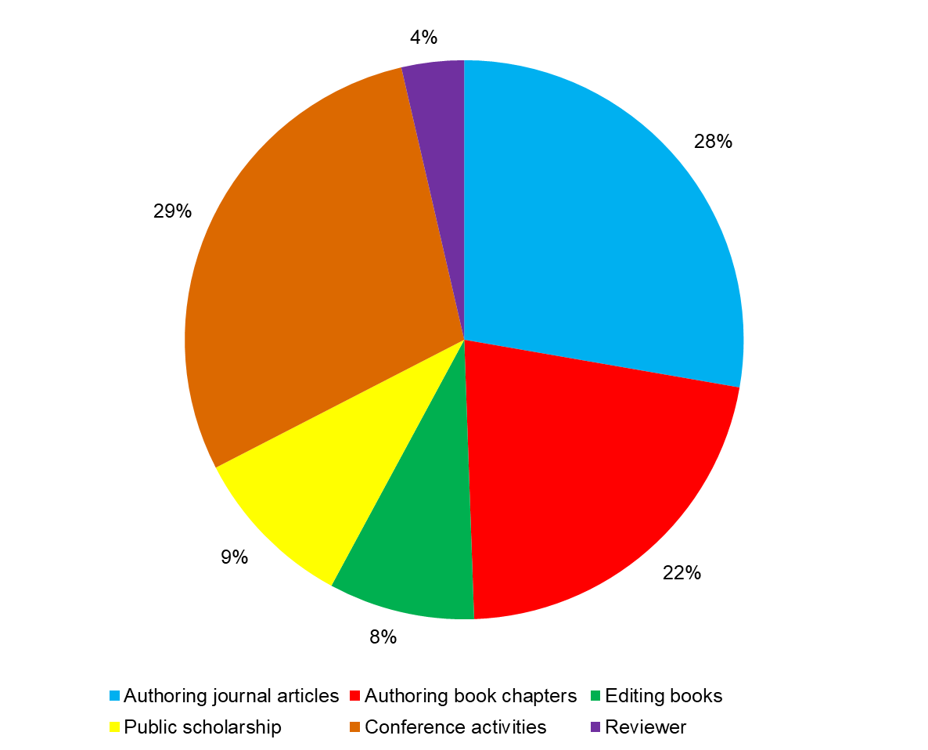
Scholarly Activity – Which of the following types of activities do you engage in?

Slide 11
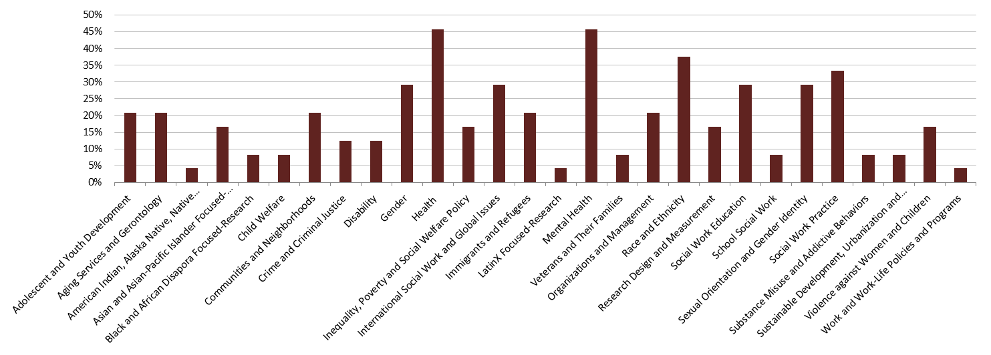
Research Focus Areas
Top 5 areas: Health, mental health, race/ethnicity, SW practice, gender, gender id/sexuality, international social work, social work education

Slide 12
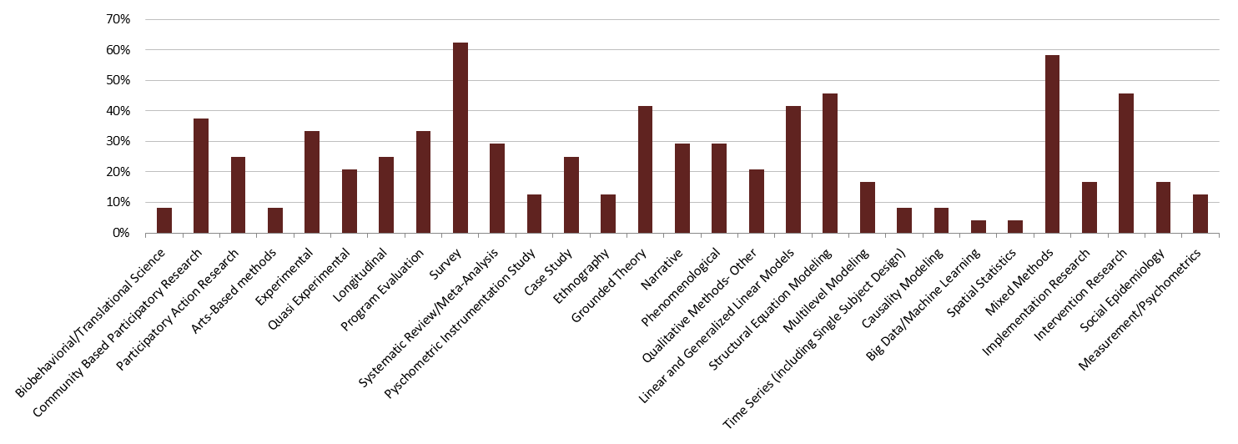
Research Methods / Approach
Top 5 areas: Survey, mixed methods, SEM, intervention research, grounded theory, linear models

Slide 13
Practice Areas that Inform Scholarship
Clinical
Practice
Group
Practice
Community
Organizing
Admin
Policy
Practice
Program
Development
& Evaluation
Abby Ross
Amy Horowitz
Cathy Berkman
Dan Coleman
Derek Tice-Brown
Howard Robinson
Janna Heyman
Jordan DeVylder
Judith R. Smith
Lauri Goldkind
Liz Matthews
Mary Ann Forgey
Sameena Azhar
Tina Maschi
Howard Robinson
Laura J Wernick
Tina Maschi
Howard Robinson
Kimberly Hudson
Laura J Wernick
Marciana Popescu
Rahbel Rahman
Dana Marlowe
Derek Tice-Brown
Howard Robinson
Kimberly Hudson
Laura J Wernick
Lauri Goldkind
Liz Matthews
Rahbel Rahman
Tina Maschi
Abby Ross
Amy Horowitz
Cathy Berkman
Derek Tice-Brown
Fuhua Zhai
Gregory Acevedo
Howard Robinson
Janna Heyman
Kimberly Hudson
Laura J Wernick
Lauri Goldkind
Marciana Popescu
Sameena Azhar
Tina Maschi
Winnie Kung
Rahbel Rahman
Abby Ross
Amy Horowitz
Cathy Berkman
Dan Coleman
Fuhua Zhai
Howard Robinson
Janna Heyman
Laura J Wernick
Lawrence Framer
Marciana Popescu
Mary Ann Forgey
Tina Maschi

Slide 14
Theoretical Perspectives
Human Rights & Justice
Person & Person in Environment
Stress & Coping, Trauma & Resilience
Critical Theories
Public Health
Kimberly Hudson Laura Wernick Lauri Goldkind Marciana Popescu
Amy Horowitz Dana Marlowe Gregory Acevedo Howard Robinson Judith Smith Liz Matthews Mary Ann Forgey Rahbel Rahman Tina Maschi Winnie Kung
Amy Horowitz Derek Tice-Brown Howard Robinson Jordan DeVylder Tina Maschi Winnie Kung
Derek Tice-Brown Gregory Acevedo Howard Robinson Kimberly Hudson Laura Wernick Sameena Azhar
Abby Ross Amy Horowitz Dana Marlowe Kimberly Hudson Liz Matthews Rahbel Rahman

Slide 15
Research Methods: Qualitative N= 14 (58%)
Grounded Theory
Phenomenology
Narrative
Ethnography
Cathy Berkman
Dana Marlowe
Howard Robinson
Judith R. Smith
Laura J Wernick
Liz Matthews
Mary Ann Forgey
Tina Maschi
Winnie Kung
Dana Marlowe
Howard Robinson
Kimberly Hudson
Laura J Wernick
Lauri Goldkind
Sameena Azhar
Tina Maschi
Abby Ross
Howard Robinson
Judith R. Smith
Laura J Wernick
Marciana Popescu
Sameena Azhar
Howard Robinson
Laura J Wernick

Slide 16
Research Methods: Quantitative N=19 (79%)
Experimental
Longitudinal
Linear & Generalized Linear Model
Structural Equation Modeling
Abby Ross
Dan Coleman
Fuhua Zhai
Janna Heyman
Jordan DeVylder
Lawrence Framer
Liz Matthews
Winnie Kung
Abby Ross
Amy Horowitz
Fuhua Zhai
Janna Heyman
Jordan DeVylder
Laura Wernick
Abby Ross
Amy Horowitz
Cathy Berkman
Fuhua Zhai
Janna Heyman
Laura J Wernick
Lawrence Farmer
Liz Matthews
Marciana Popescu
Sameena Azhar
Abby Ross
Amy Horowitz
Dan Coleman
Derek Tice-Brown
Kimberly Hudson
Laura J Wernick
Lauri Goldkind
Lawrence Farmer
Rahbel Rahman
Sameena Azhar
Tina Maschi
Time Series
Quasi Experimental
Marciana Popescu
Tina Maschi
Multilevel Modeling
Causality Modeling
Amy Horowitz
Fuhua Zhai
Howard Robinson
Lawrence Farmer
Liz Matthews
Abby Ross
Fuhua Zhai
Laura J Wernick
Liz Matthews
Fuhua Zhai
Tina Maschi
Notes:
19

Slide 17
Research Methods: Other
Community Based Participatory Research
Survey
Program Evaluation
Bio-behaviorial / Translation Science
Arts-Based methods
Abby Ross
Amy Horowitz
Cathy Berkman
Dan Coleman
Fuhua Zhai
Janna Heyman
Jordan DeVylder
Kimberly Hudson
Laura J Wernick
Lauri Goldkind
Mary Ann Forgey
Rahbel Rahman
Sameena Azhar
Tina Maschi
Winnie King
Abby Ross
Howard Robinson
Janna Heyman
Laura J Wernick
Lauri Goldkind
Marciana Popescu
Rahbel Rahman
Sameena Azhar
Tina Maschi
Abby Ross
Amy Horowitz
Cathy Berkman
Derek Tice-Brown
Lawrence Framer
Howard Robinson
Janna Heyman
Tina Maschi
Abby Ross
Howard Robinson
Howard Robinson
Tina Maschi
Systematic Review/Meta-Analysis
Case Study
Abby Ross
Janna Heyman
Jordan DeVylder
Kimberly Hudson
Lauri Goldkind
Sameena Azhar
Tina Maschi
Participatory Action Research
Abby Ross
Howard Robinson
Laura J Wernick
Rahbel Rahman
Tina Maschi
Howard Robinson
Laura J Wernick
Lauri Goldkind
Marciana Popescu
Rahbel Rahman
Tina Maschi

Slide 18
Research Focus Areas
Health
Child Welfare
Violence against Women & Children
Communities & Organizations
Aging Services & Gerontology
Social Work Education
Abby Ross
Cathy Berkman
Dana Marlowe
Derek Tice-Brown
Howard Robinson
Janna Heyman
Kimberly Hudson
Liz Matthews
Rahbel Rahman
Sameena Azhar
Tina Maschi
Fuhua Zhai
Howard Robinson
Howard Robinson
Judith R. Smith
Marciana Popescu
Sameena Azhar
Gregory Acevedo
Howard Robinson
Janna Heyman
Kimberly Hudson
Laura J Wernick
Lauri Goldkind
Liz Matthews
Rahbel Rahman
Amy Horowitz
Cathy Berkman
Janna Heyman
Judith R. Smith
Tina Maschi
Abby Ross
Howard Robinson
Dana Marlowe
Howard Robinson
Janna Heyman
Kimberly Hudson
Mary Ann Forgey
Tina Maschi
Winnie Kung
Jordan DeVylder
Lawrence Farmer
Tina Maschi
Crime & Criminal Justice
Dan Coleman
Jordan DeVylder
Tina Maschi
Adolescent & Youth Development
International Social Work, and Global Issues
Substance Misuse and Addictive Behaviors
Abby Ross
Howard Robinson
Jordan DeVylder
Lawrence Farmer
Tina Maschi
Inequality, Poverty, & Social Welfare Policy
Research Design and Measurement
Gregory Acevedo
Howard Robinson
Marciana Popescu
Mary Ann Forgey
Rahbel Rahman
Sameena Azhar
Winnie Kung
Military Service Members, Veterans & Their Families
Janna Heyman
Sameena Azhar
Fuhua Zhai
Gregory Acevedo
Howard Robinson
Laura J Wernick
School Social Work
Fuhua Zhai
Howard Robinson
Janna Heyman
Jordan DeVylder
Howard Robinson
Lawrence Farmer
Howard Robinson
Mary Ann Forgey

Slide 19
Research Focus Area: Social Groups (what to call this?)
Race & Ethnicity
Immigrants & Refugees
American Indian, Alaska Native, Native Hawaiian & Global Indigenous Populations
Gender
Cathy Berkman
Derek Tice-Brown
Gregory Acevedo
Howard Robinson
Kimberly Hudson
Laura J Wernick
Sameena Azhar
Winnie Kung
Cathy Berkman
Derek Tice-Brown
Judith R. Smith
Kimberly Hudson
Laura J Wernick
Sameena Azhar
Fuhua Zhai
Gregory Acevedo
Howard Robinson
Marciana Popescu
Winnie King
Howard Robinson
Disability
Asian & Asian-Pacific Islander
Focused-Research
Sexual Orientation and Gender Identity
Amy Horowitz
Howard Robinson
Laura J Wernick
Black & African Diaspora
Cathy Berkman
Fuhua Zhai
Sameena Azhar
Winnie Kung
Cathy Berkman
Derek Tice-Brown
Kimberly Hudson
Laura J Wernick
Sameena Azhar
Tina Maschi
Howard Robinson

